Slide 1

UNIT 2
Chapter 3: Atomic Models and Properties of Atoms
: Atomic Models and Properties of Atoms
Historically, scientists have used their knowledge of atomic properties to develop and refine atomic models. Today, this knowledge is applied to various research techniques.
Scientists can now determine colour patterns of ancient bird feathers by identifying elements present in fossils of the birds.
TO PREVIOUS SLIDE

Slide 2
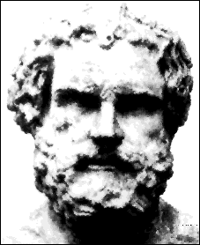
Democritus
This is the Greek philosopher Democritus who began the search for a description of matter more than 2400 years ago.
He asked: Could matter be divided into smaller and smaller pieces forever, or was there a limit to the number of times a piece of matter could be divided?

Slide 3

Atomos
His theory: Matter could not be divided into smaller and smaller pieces forever, eventually the smallest possible piece would be obtained.
This piece would be indivisible.
He named the smallest piece of matter “atomos,” meaning “not to be cut.”

Slide 4
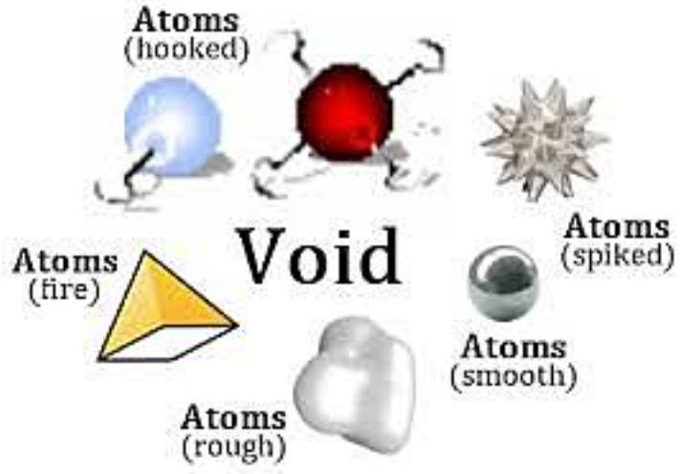
Atomos
To Democritus, atoms were small, hard particles that were all made of the same material but were different shapes and sizes.
Atoms were infinite in number, always moving and capable of joining together.

Slide 5

This theory was ignored and forgotten for more than 2000 years!
Notes:
Scientists’ models of the atom have dramatically changed over the last 200 years. In that relatively short timeframe, the atomic model has gone from being compared to lawn-bowling balls (Dalton’s model) to plum pudding (Thomson’s model) to a planetary system (Rutherford’s and Bohr’s models). Today’s quantum mechanical model is only best described mathematically, attributing both wave-like properties and particle-like properties to electrons.

Slide 6
START HERE P3 -> Do nature of sci activity

Slide 7
UNIT 2
Chapter 3: Atomic Models and Properties of Atoms
Section 3.1
3.1 Developing a Nuclear Model of the Atom
Dalton’s model (1808)
We will take a look at each of these models on the coming slides
Thomson’s model (1904)
Rutherford’s model (1911)
Bohr’s model (1913)
quantum mechanical model (present)
TO PREVIOUS SLIDE

Slide 8
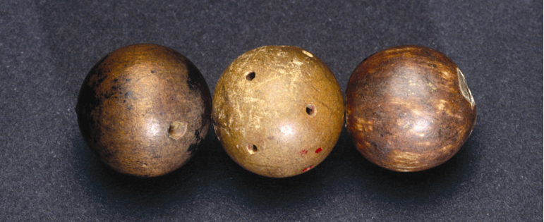

UNIT 2
Chapter 3: Atomic Models and Properties of Atoms
Section 3.1
Reviewing the Atomic Models of Dalton and Thomson
John Dalton’s model of the atom: The Indivisible Atom
marked the beginning of a new way of explaining matter
matter was described as being composed of small, indivisible spheres, which Dalton called atoms
Dalton envisioned atoms as hard, solid spheres.
Why did the discovery of subatomic particles like electrons require a new atomic model?
TO PREVIOUS SLIDE

Slide 9
Subatomic particles showed the atom WAS divisible and made of smaller particles.

Slide 10

Dalton’s Model
In the early 1800s, the English Chemist John Dalton performed a number of experiments that eventually led to the acceptance of the idea of atoms.

Slide 11

Dalton’s Theory
All matter is made of tiny indivisible and indestructible particles called atoms.
Atoms of the same element are exactly alike (properties, mass, etc).
Atoms of different elements are different in properties and mass.
Atoms of different elements (and a few with themselves), combine in small whole number ratios to form compounds
In chemical reactions, atoms are not created or destroyed. They are rearranged or combined.

Slide 12

.
This theory became one of the foundations of modern chemistry.

Slide 13
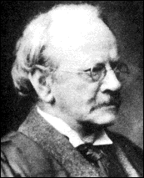
Thomson’s Plum Pudding Model
In 1897, the English scientist J.J. Thomson provided the first hint that an atom is made of even smaller particles.

Slide 14
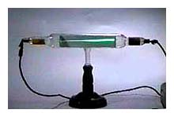
Thomson Model
Thomson studied the passage of an electric current through a gas.
As the current passed through the gas, it gave off rays of negatively charged particles (ie….).

Slide 15
Start here P2

Slide 16
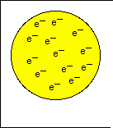

Thomson Model
“Plum Pudding”
The atom is a spherical cloud of positive charge with negatively charged electrons embedded in it
The amount of positive charge equals the amount of negative charge, so the entire atom is neutral.

Slide 17
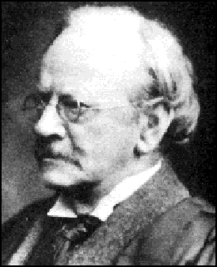
Thomson Model
Where did they come from?
This surprised Thomson, because the atoms of the gas were uncharged. Where had the negative charges come from?

Slide 18

Thomson concluded that the negative charges came from within the atom.
A particle smaller than an atom had to exist.
The atom was divisible!
Thomson called the negatively charged “corpuscles,” today known as electrons.
Since the gas was known to be neutral, having no charge, he reasoned that there must be positively charged particles in the atom.
But he could never find them.

Slide 19


Slide 20
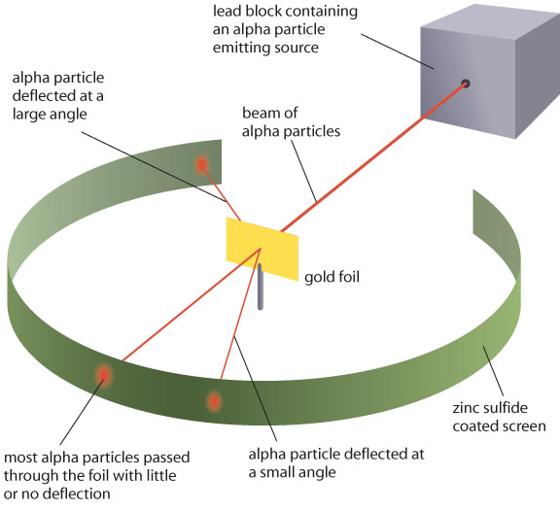
UNIT 2
Chapter 3: Atomic Models and Properties of Atoms
Section 3.1
Rutherford’s Gold Foil Experiments
Alpha (positively charged, 2p+2n) particles were aimed at gold foil. The scattering of the alpha particles was monitored.
Expectation (Thomson’s model):
particles pass through or some slightly deflected
Observation:
some particles deflected at large angles
Rutherford’s experimental observations required a new atomic model.

Slide 21
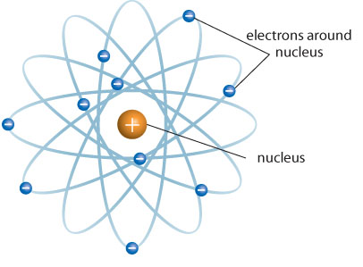
UNIT 2
Chapter 3: Atomic Models and Properties of Atoms
Section 3.1
Rutherford’s Nuclear Atomic Model
Rutherford’s model of the atom:
large deflections of particles proposed to be due to presence of an electric field at the centre of the atom (he knew positive repelled positive)
an atom has a positively charged nucleus at the centre with electrons scattered in motion surrounding the nucleus
The nuclear, or planetary model, of the atom.
TO PREVIOUS SLIDE

Slide 22
Rutherford’s Gold Foil Expt Conclusions
The atoms is mostly empty space
Most of the mass is concentrated in a small, dense, nucleus
Electrons move around the nucleus like planets around the sun

Slide 23


Slide 24
Moseley and the Atomic Number
Prior to Mosely, the atomic number was thought of as a somewhat arbitrary number related to, but separate from, atomic mass
Henry Moseley found that certain lines in the X-ray spectrum of each element moved the same amount (linear relationship) each time the atomic number increased by one.
This yielded, for the first time, a measurable property of the nucleus that was directly related to atomic number
IMPORTANT TAKEAWAY: The number of protons determines the identity of the element – the atomic number Z

Slide 25
Atomic notation and Isotopes
Z = atomic number A = atomic mass
What is atomic mass?
How can we calculate the number of neutrons?
If two atoms have the SAME atomic number (Z) but different atomic masses (A), they are….?
How will their properties compare?
What if they have DIFFERENT atomic numbers (Z) but the SAME atomic masses (A)?

Slide 26
ANSWERS: Atomic notation and Isotopes
Z = atomic number A = atomic mass
What is atomic mass? Number of protons + Neutrons
How can we calculate the number of neutrons?
Neutrons = Atomic mass - atomic number
If two atoms have the SAME atomic number (Z) but different atomic masses (A), they are….? Isotopes (SAME element but diff number of neutrons
How will their properties compare? Isotopes have the SAME properties
What if they have DIFFERENT atomic numbers (Z) but the SAME atomic masses (A)? They are DIFFERENT elements and the same mass is just a coincidence.

Slide 27
End Here → Next The Bohr_Rutherford Model PP (The Nuclear model)

Slide 28
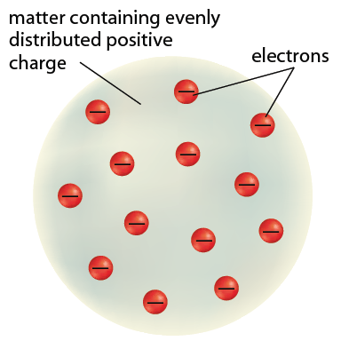
UNIT 2
Chapter 3: Atomic Models and Properties of Atoms
Section 3.1
Reviewing the Atomic Models of Dalton and Thomson
J.J. Thomson’s model of the atom:
incorporated his discovery of the electron, using cathode ray tubes
an atom is a positively charged spherical mass with negatively charged electrons embedded within
Thomson’s “plum pudding” model of the atom.
TO PREVIOUS SLIDE

Slide 29
NEXT TIME:
Atomic Numbers and Isotopes
Towards the development of the Quantum Model of the Atom

Slide 30
UNIT 2
Chapter 3: Atomic Models and Properties of Atoms
Section 3.1
The Limitations of Rutherford’s Atomic Model
Based on the understanding of physics at the time, for an electron in motion around a central core:
radiation must be emitted, so it was expected that a continuous spectrum of light energy was being given off
because of radiation, the electron would lose energy and its orbit would decrease until it spiraled into the nucleus, destroying the atom
TO PREVIOUS SLIDE

Slide 31
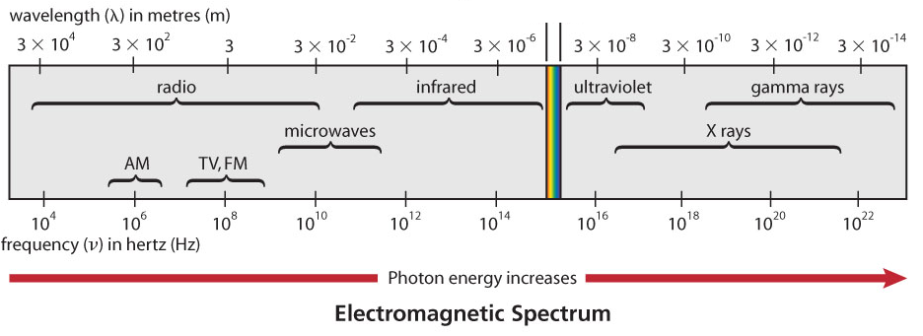
UNIT 2
Chapter 3: Atomic Models and Properties of Atoms
Section 3.1
Rethinking Atomic Structure Based on the Nature of Energy
Light is one form of electromagnetic radiation, which
travels through space as waves
Electromagnetic waves:
have frequency, wavelength, and amplitude
interact with matter in discrete particles called photons
TO PREVIOUS SLIDE

Slide 32
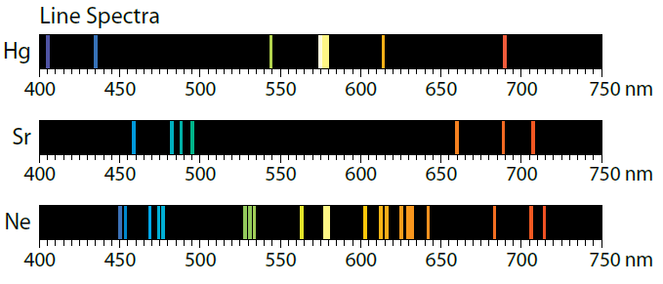
UNIT 2
Chapter 3: Atomic Models and Properties of Atoms
Section 3.1
Atomic Spectra
When atoms are excited due to absorption of energy, they emit light as they lose energy and return to a non-excited state.
Atoms of each element emit light of particular wavelengths called a line spectrum or emission spectrum.
Each element has a characteristic line spectrum.
TO PREVIOUS SLIDE

Slide 33
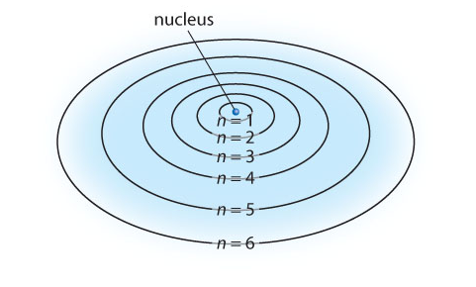
UNIT 2
Chapter 3: Atomic Models and Properties of Atoms
Section 3.1
The Bohr Model of the Hydrogen Atom
Niels Bohr set out to explain the stability of the nuclear model of the atom. In this model, electrons
are in circular orbits
can only exist in certain “allowed” orbits or energy levels (energy of electrons is quantized)
do not radiate energy while in one orbit
can jump between orbits by gaining or losing a specific amount of energy
TO PREVIOUS SLIDE

Slide 34
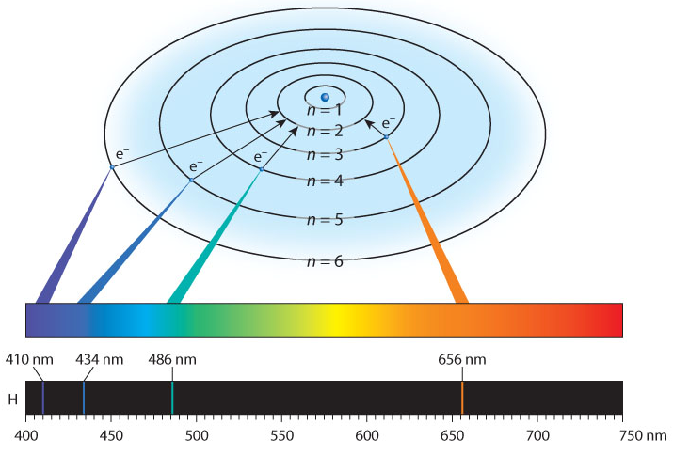
UNIT 2
Chapter 3: Atomic Models and Properties of Atoms
Section 3.1
Bohr’s Atomic Model Explains the Line Spectrum of Hydrogen
Calculated wavelengths of the possible energies of photons that could be emitted from an excited hydrogen atom (transitions from n = 6, 5, 4, and 3 to n = 2) corresponded with hydrogen’s visible line spectrum
Limitations
could only explain single-electron systems (H, He⁺, Li²⁺⁾
TO PREVIOUS SLIDE

Slide 35
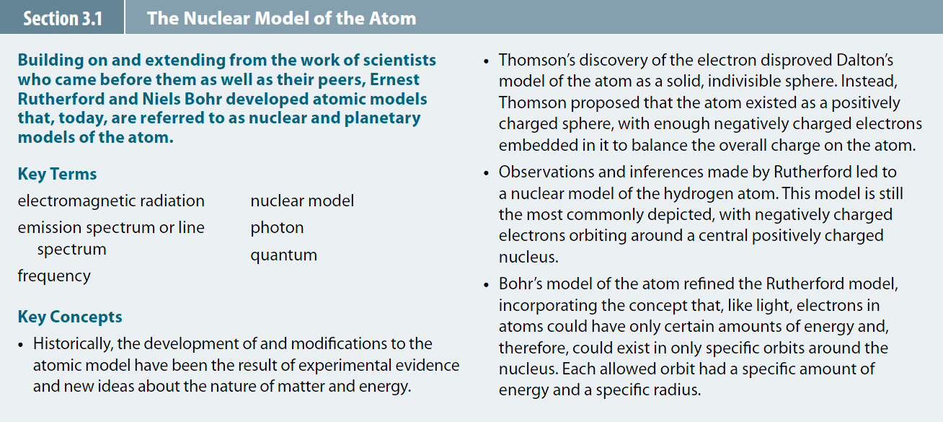
UNIT 2
Chapter 3: Atomic Models and Properties of Atoms
Section 3.1
Section 3.1 Review
TO PREVIOUS SLIDE

Slide 36

UNIT 2
Chapter 3: Atomic Models and Properties of Atoms
Section 3.2
3.2 The Quantum Mechanical Model of the Atom
Today’s quantum mechanical model of the atom incorporates the wave properties of electrons.
Wave functions, initially described by Erwin Schrodinger, represent a region in space around a nucleus where an electron will be found. This region of space is called an atomic orbital
An electron density diagram represents an atomic orbital.
TO PREVIOUS SLIDE

Slide 37
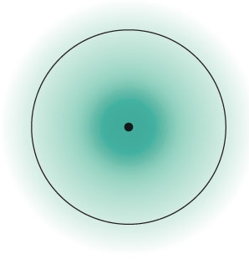
UNIT 2
Chapter 3: Atomic Models and Properties of Atoms
Section 3.2
The Quantum Mechanical Model of the Atom
Atomic orbitals can be visualized as “fuzzy clouds”
The higher the density of the “cloud,” the higher the probability of finding an electron at that point.
The cloud has no definite boundary.
The region where an electron will spend 90 percent of its time is depicted by drawing a circle.
The circle does not represent a real boundary.
TO PREVIOUS SLIDE

Slide 38
UNIT 2
Chapter 3: Atomic Models and Properties of Atoms
Section 3.1
Quantum Numbers Describe Orbitals
Electrons in the quantum mechanical model of the atom are described using quantum numbers.
Three quantum numbers describe the distribution of electrons in the atom and a fourth describes the behaviour of each electron.
Symbols for the four quantum numbers:
n
l
m_{l}
m_{s}
TO PREVIOUS SLIDE

Slide 39
UNIT 2
Chapter 3: Atomic Models and Properties of Atoms
Section 3.2
The Principle Quantum Number, n
Is the first quantum number
Describes the energy level, or shell, of an orbital
All orbitals with the same n value are in the same shell
The larger the n value, the larger the size of the shell
Values can range from n = 1 to n = ∞
n = 1 first shell
n = 2 second shell
n = 3 third shell
n = 4 fourth shell
TO PREVIOUS SLIDE

Slide 40
UNIT 2
Chapter 3: Atomic Models and Properties of Atoms
Section 3.2
The Orbital-Shape Quantum Number, l
Is the second quantum number
Describes the shape of an orbital
Refers to energy sublevels, or subshells
Values depend on the value of n. They are positive integers from 0 to (n – 1)
Each value is identified by a letter
l = 0 orbital s
l = 1 orbital p
l = 2 orbital d
l = 3 orbital f
An energy sublevel is identified by combining n with the orbital letter. For example, n = 2, l = 1: 2p sublevel
TO PREVIOUS SLIDE

Slide 41
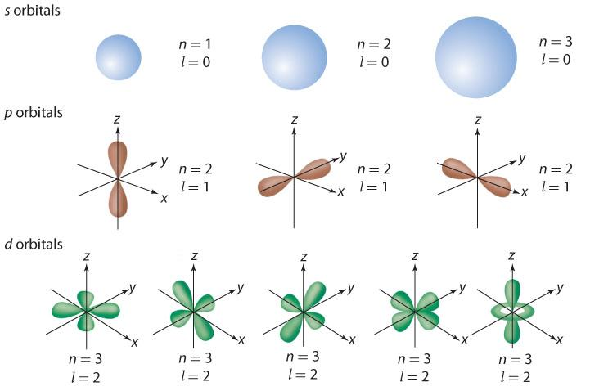
UNIT 2
Chapter 3: Atomic Models and Properties of Atoms
Section 3.2
The Magnetic Quantum Number, m_{l}
Is the third quantum number
Indicates the orientation of the orbital in space
For a given l there are (2l +1) values for m_{l}
The total number of orbitals for an energy level is n²
s, p, and d orbitals have characteristic shapes.
TO PREVIOUS SLIDE
Notes:
Answer to question prompt: helium

Slide 42
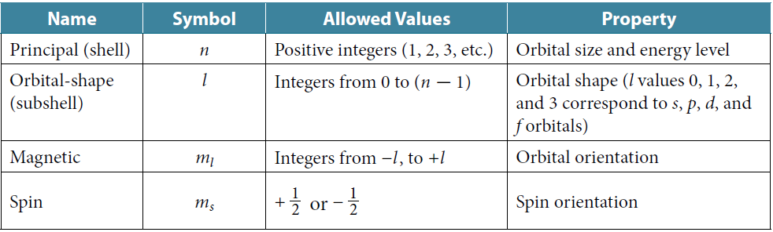
UNIT 2
Chapter 3: Atomic Models and Properties of Atoms
Section 3.2
The Spin Quantum Number, m_{s}
Is the fourth quantum number
Specifies the orientation of the axis of electron spin
Two possible values: +½ or –½
To summarize:
TO PREVIOUS SLIDE

Slide 43
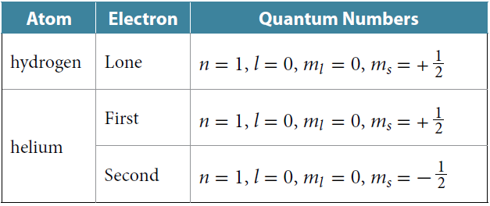
UNIT 2
Chapter 3: Atomic Models and Properties of Atoms
Section 3.2
Identifying Electrons Using Sets of Quantum Numbers
According to the Pauli exclusion principle:
an orbital can have a maximum of two electrons
two electrons in an orbital must have opposite spins
No two electrons of an atom have the same set of four quantum numbers.
TO PREVIOUS SLIDE
Notes:
Electron configurations are closely related to the structure of the periodic table.
Electron configurations for elements in the periodic table can be written by “building up” the electron configuration of the first element, adding one electron at a time to its lowest available energy level in order of increasing atomic number..
Guidelines 3 and 4 reflect Hund's rule:
A rule stating that the lowest energy state for an atom has the maximum number of unpaired electrons allowed by the Pauli exclusion principle in a given energy sublevel.

Slide 44
UNIT 2
Chapter 3: Atomic Models and Properties of Atoms
Section 3.2
LEARNING CHECK
What is the set of quantum numbers for an electron in a 2s orbital?
Answer on the next slide
TO PREVIOUS SLIDE
Notes:
Note: only a partial list of Period 3 elements is shown on this slide.

Slide 45
UNIT 2
Chapter 3: Atomic Models and Properties of Atoms
Section 3.2
LEARNING CHECK
n =2, l = 0, m_{l} = 0, m_{s} = +½
TO PREVIOUS SLIDE

Slide 46
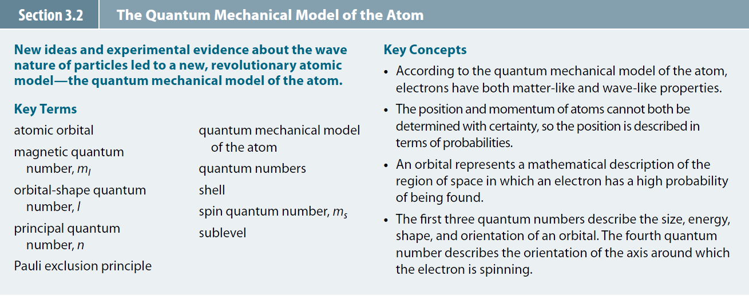
UNIT 2
Chapter 3: Atomic Models and Properties of Atoms
Section 3.2
Section 3.2 Review
TO PREVIOUS SLIDE

Slide 47
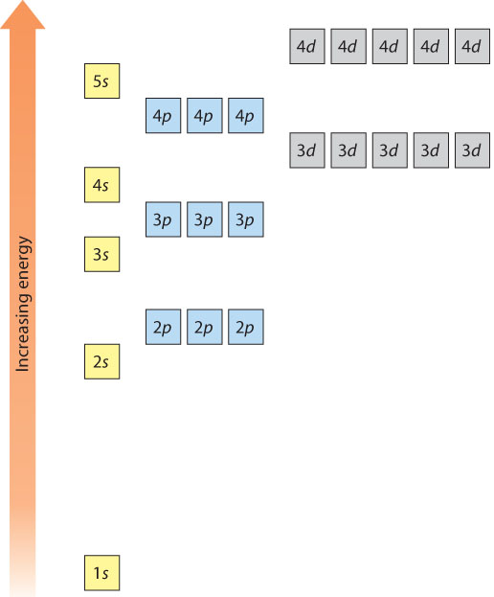

UNIT 2
Chapter 3: Atomic Models and Properties of Atoms
Section 3.3
3.3 Electron Configurations and the Periodic Table
For atoms with two or more electrons:
electrons in different orbitals with the same n value have different energies.
electrons within a sublevel have the same energy.
TO PREVIOUS SLIDE
Notes:
Note: only a partial list of Period 4 elements is shown on this slide.
For the two exceptions to following the guidelines:
Experimental evidence supports this electron configuration. The atoms appear to be more stable when all of the d orbitals are half-filled (for Cr) or completely filled (for Cu) instead of the s orbitals being filled.

Slide 48
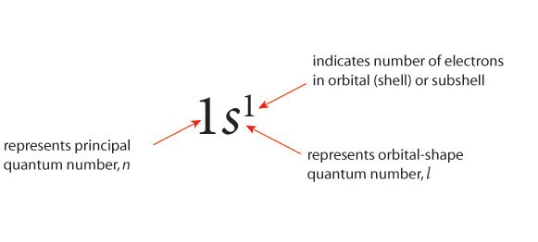
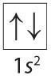
UNIT 2
Chapter 3: Atomic Models and Properties of Atoms
Section 3.3
Representing Electrons: Electron Configurations and Orbital Diagrams
The electron configuration for an atom shows the number and arrangement of its electrons, in the ground state.
The electron configuration for hydrogen
An orbital diagram uses boxes or lines to represent orbitals at each n and shows electron spin.
Orbital diagrams often accompany electron configurations.
Identify the atom.
TO PREVIOUS SLIDE
Notes:
s-Block Elements
Valence electrons occupy only the s orbitals, with Group 1 elements having electron configurations ending in ns¹ and Group 2 elements having electron configurations ending in ns².
p-Block Elements
Elements have filled or partially filled p orbitals. Group 18 elements have fully occupied s and p orbitals with the general electron configuration ns²np⁶
d-Block Elements
Except for a few exceptions, elements have filled s orbitals and filled or partially filled d orbitals of energy level n - 1.
f-Block Elements
Elements have filled s orbitals in the outer energy levels and filled or partially filled 4f and 5f orbitals.

Slide 49
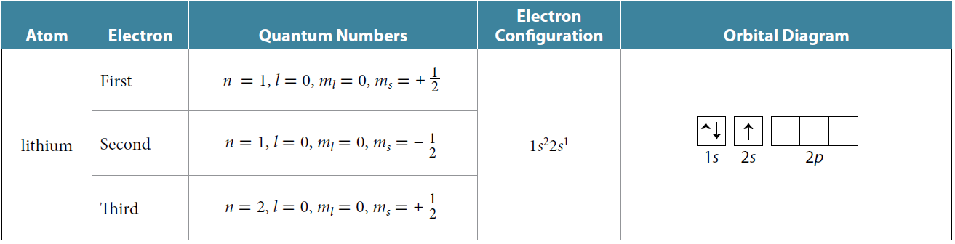
UNIT 2
Chapter 3: Atomic Models and Properties of Atoms
Section 3.3
Describing the Electrons in Lithium
The lithium atom has three electrons:
The first two electrons occupy the 1s orbital (n = 1)
The third electron is at an n = 2 energy level
l can be 0 or 1; l = 0 (s) is lower in energy than l = 1 (p)
TO PREVIOUS SLIDE

Slide 50
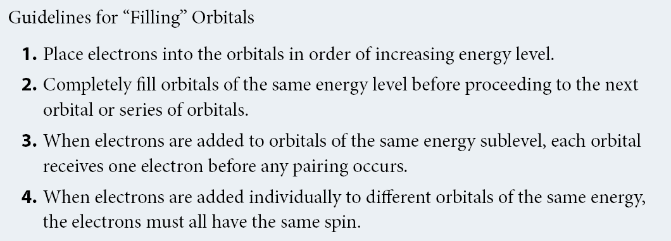
UNIT 2
Chapter 3: Atomic Models and Properties of Atoms
Section 3.3
Writing Electron Configurations and Orbital Diagrams
Follow the aufbau principle:
“build up” electronic configurations of atoms in order of increasing atomic number
TO PREVIOUS SLIDE

Slide 51
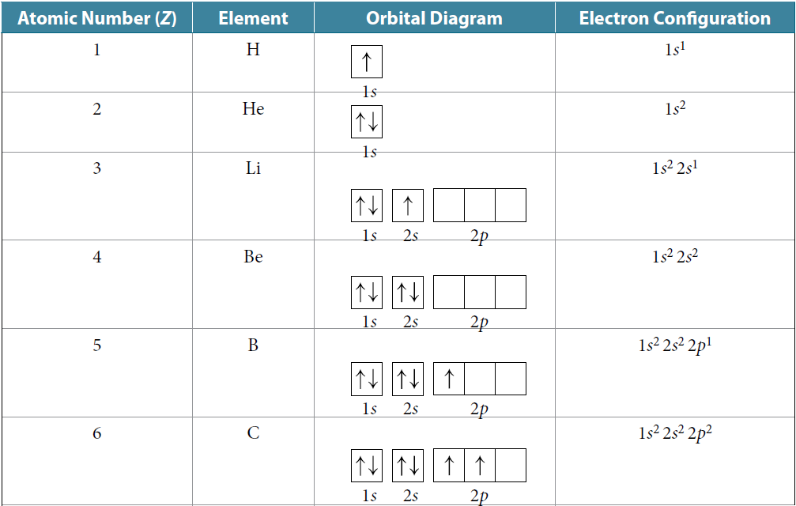
UNIT 2
Chapter 3: Atomic Models and Properties of Atoms
Section 3.3
Filling Orbitals for Periods 1 and 2
Boxes in orbital diagrams are written and filled from left to right (increasing energy of orbitals)
For C apply Hund’s rule and for O apply Pauli exclusion principle
TO PREVIOUS SLIDE

Slide 52
UNIT 2
Chapter 3: Atomic Models and Properties of Atoms
Section 3.3
LEARNING CHECK
Write the electron configurations and draw orbital diagrams for N and F.
Answer on the next slide
TO PREVIOUS SLIDE
Notes:
The size of an atom is its atomic radius. It is determined by measuring the distance between nuclei of identical atoms that are bonded together in molecules or are neighbouring atoms in a crystal.

Slide 53
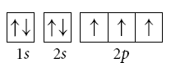
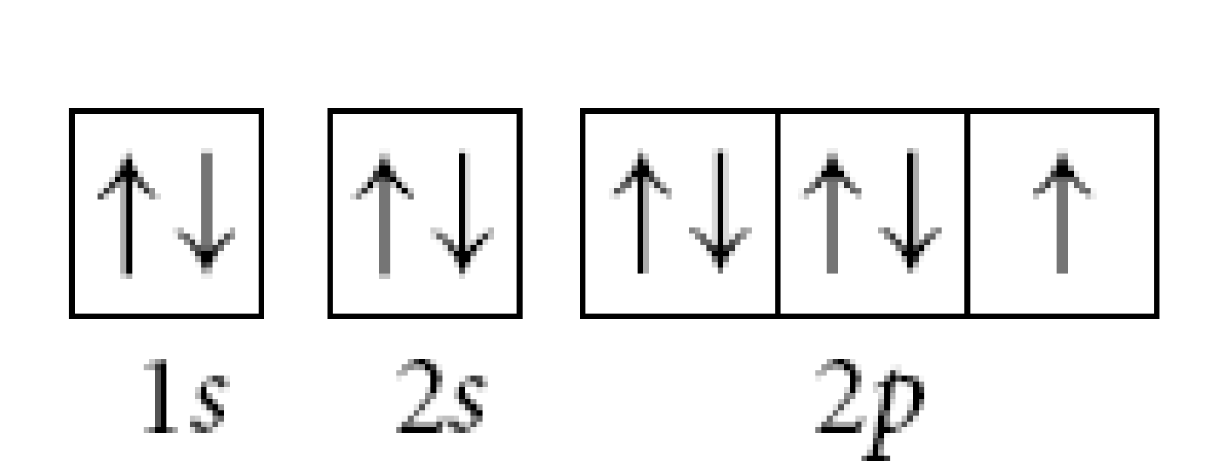
UNIT 2
Chapter 3: Atomic Models and Properties of Atoms
Section 3.3
LEARNING CHECK
For nitrogen:
1s²2s²2p³
For fluorine:
1s²2s²2p⁵
TO PREVIOUS SLIDE
Notes:
Ionization energy is the energy required to remove an electron from a ground-state atom in the gaseous state.

Slide 54
UNIT 2
Chapter 3: Atomic Models and Properties of Atoms
Section 3.3
Filling Orbitals for Period 3
Follow the same guidelines as done for Period 1 and 2 elements
Use condensed electron configuration and corresponding partial orbital diagrams
Full for Z = 11:
1s²2s²2p⁶3s¹
Condensed for Z = 11:
[Ne]3s¹
For filling orbitals for transition and Group 12 elements:
Keep in mind that the order of orbital energies is
TO PREVIOUS SLIDE
Notes:
Electron affinity is the energy change associated with the addition of an electron to an atom.

Slide 55
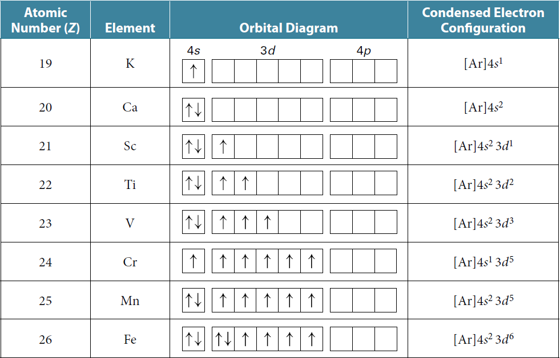
UNIT 2
Chapter 3: Atomic Models and Properties of Atoms
Section 3.3
Filling Orbitals for Period 4
Follow the same guidelines up to Z = 23. After that, two exceptions are Cr [Ar]4s¹3d⁵ and Cu [Ar]4s¹3d¹⁰
TO PREVIOUS SLIDE
Notes:
Answer to question prompt: Because the discovery of these subatomic particles indicated that atoms are not indivisible; they are composed of smaller components.

Slide 56
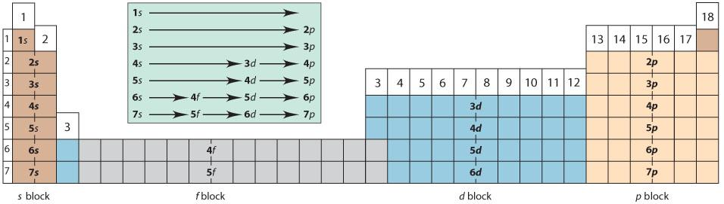
UNIT 2
Chapter 3: Atomic Models and Properties of Atoms
Section 3.3
Using the Periodic Table to Predict Electron Configurations
Based on the filling pattern of orbitals, the periodic table can be divided into s block, p block, d block, and f block regions.
TO PREVIOUS SLIDE

Slide 57
UNIT 2
Chapter 3: Atomic Models and Properties of Atoms
Section 3.3
Group and Period Numbers Provide Patterns
Elements in a group have similar electron configurations and the same number of valence electrons. Patterns include:
The last numeral of the group number is the same as the number of valence electrons for main group elements (He is an exception).
The value of n for the highest occupied orbital is the period number.
At a given energy level, the total number of orbitals is n² and the maximum number of electrons is 2n².
TO PREVIOUS SLIDE

Slide 58
UNIT 2
Chapter 3: Atomic Models and Properties of Atoms
Section 3.3
LEARNING CHECK
The condensed electron configuration for silicon is [Ne]3s²3p².
Without using a periodic table, identify the group number, period number, and orbital block for silicon.
Answer on the next slide
TO PREVIOUS SLIDE

Slide 59
UNIT 2
Chapter 3: Atomic Models and Properties of Atoms
Section 3.3
LEARNING CHECK
Group 14, Period 3, p block
TO PREVIOUS SLIDE
Notes:
‹#›

Slide 60
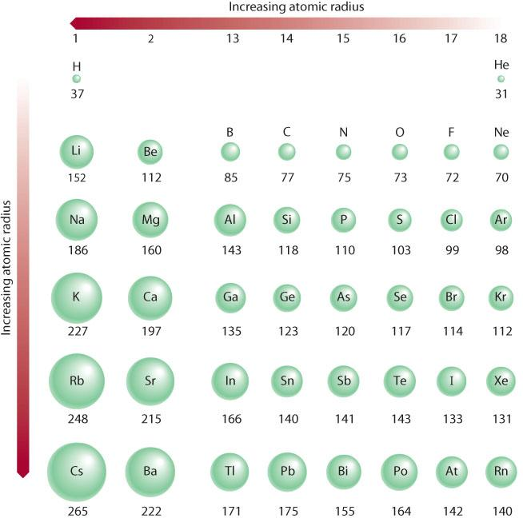
UNIT 2
Chapter 3: Atomic Models and Properties of Atoms
Section 3.3
Electron Configurations and Periodic Trends in Atomic Properties
Patterns of electron configurations in the periodic table are related to periodic trends.
Atomic radius trend:
For main group elements, generally a decrease across a period and an increase down a group.
TO PREVIOUS SLIDE
Notes:
‹#›

Slide 61
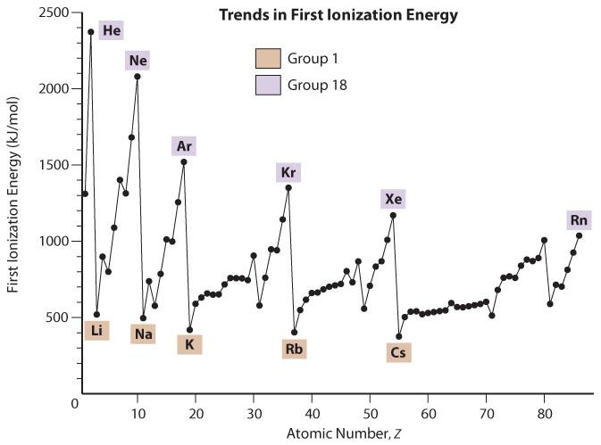
UNIT 2
Chapter 3: Atomic Models and Properties of Atoms
Section 3.3
Electron Configurations and Periodic Trends in Atomic Properties
First ionization energy is the energy required to remove the first electron from an atom.
Within a group, it generally decreases as you move down the group.
Within a period, it generally increases as you move from left to right.
TO PREVIOUS SLIDE
Notes:
‹#›

Slide 62
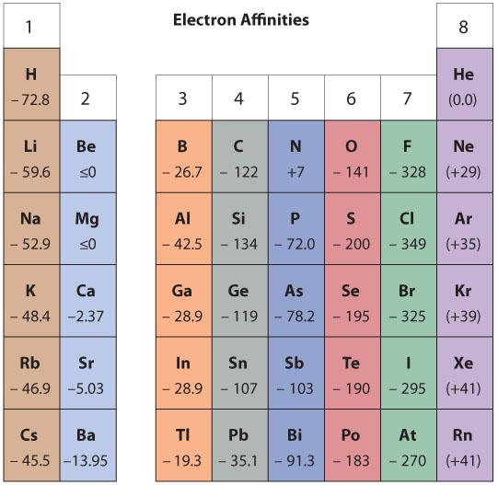
UNIT 2
Chapter 3: Atomic Models and Properties of Atoms
Section 3.3
Electron Configurations and Periodic Trends in Atomic Properties
Electron affinity:
Trend is more irregular
In combination with ionization energy, there are trends
atoms high in both electron affinity and ionization energy easily form anions
atoms low in both easily form cations
atoms with very high ionization energies and very low electron affinities do not bond (noble gases)
TO PREVIOUS SLIDE
Notes:
‹#›

Slide 63
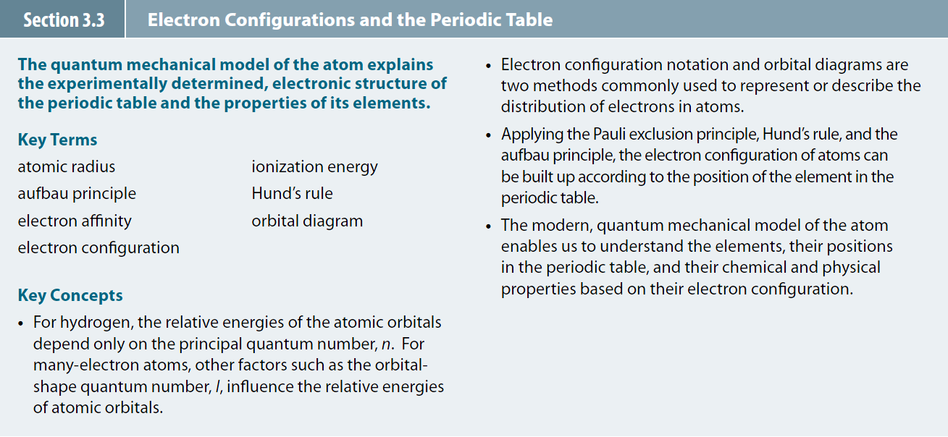
UNIT 2
Chapter 3: Atomic Models and Properties of Atoms
Section 3.3
Section 3.3 Review
TO PREVIOUS SLIDE
Notes:
‹#›

